Slide 1
Introduction to Quantum Computing: From a Layperson to a Programmer in 30 Steps
Hiu-Yung Wong
https://link.springer.com/book/10.1007/978-3-030-98339-0
https://www.amazon.com/Introduction-Quantum-Computing-Layperson-Programmer/dp/3030983382
Playlist: https://www.youtube.com/watch?v=BSz2ZmVAnyI&list=PLnK6MrIqGXsJfcBdppW3CKJ858zR8P4eP&index=40
https://www.youtube.com/watch?v=UtqGDF6KWq0&list=PLnK6MrIqGXsJfcBdppW3CKJ858zR8P4eP&index=41
https://www.youtube.com/watch?v=rjypT4wJzwY&list=PLnK6MrIqGXsJfcBdppW3CKJ858zR8P4eP&index=42

Slide 2
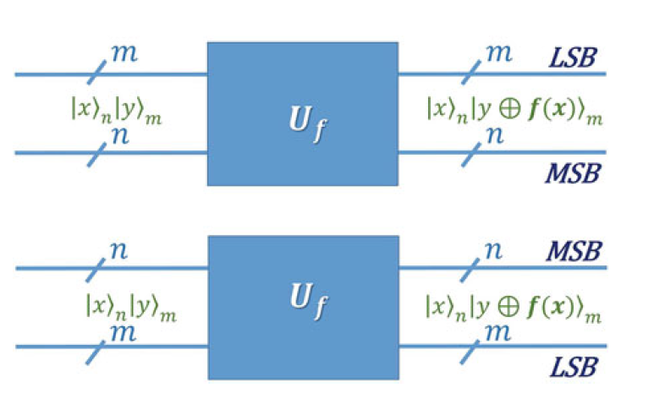

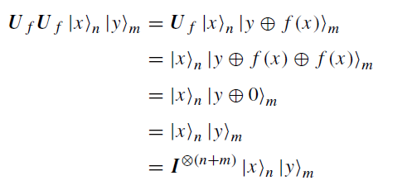




XOR Oracle
$$f:{\left\{0,1\right\}}^{n}⟶{\left\{0,1\right\}}^{m}$$
Advantages:
Input and output have the same number of bits (n+m)
Reversible by construction
To prove it is unitary, see Q22.2 in chapter 22 in the textbook.

Slide 3


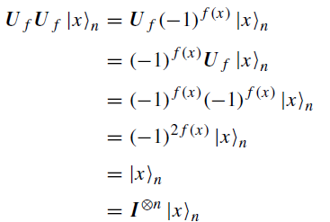
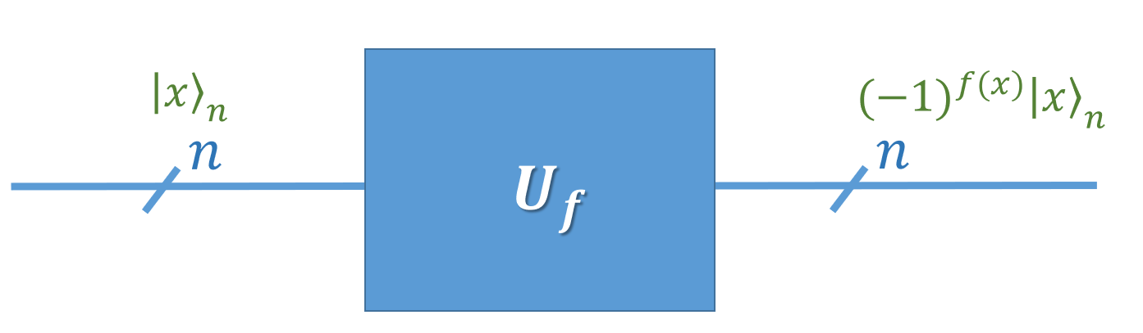
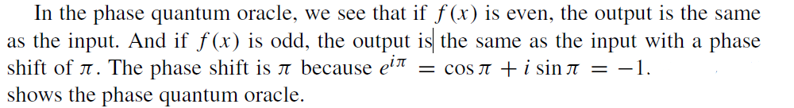
Phase Oracle

Slide 4




Complexity of Algorithms
In an addition operation:
Take 1 second to add 1 digit, for N-digits
What if take log(N) seconds to add N digits?
What if take √N seconds to add N digits?
quadratic speedup
exponential speedup over the classical
algorithm.
= 0 second
10 = 1 second
quadratic speedup

Slide 5
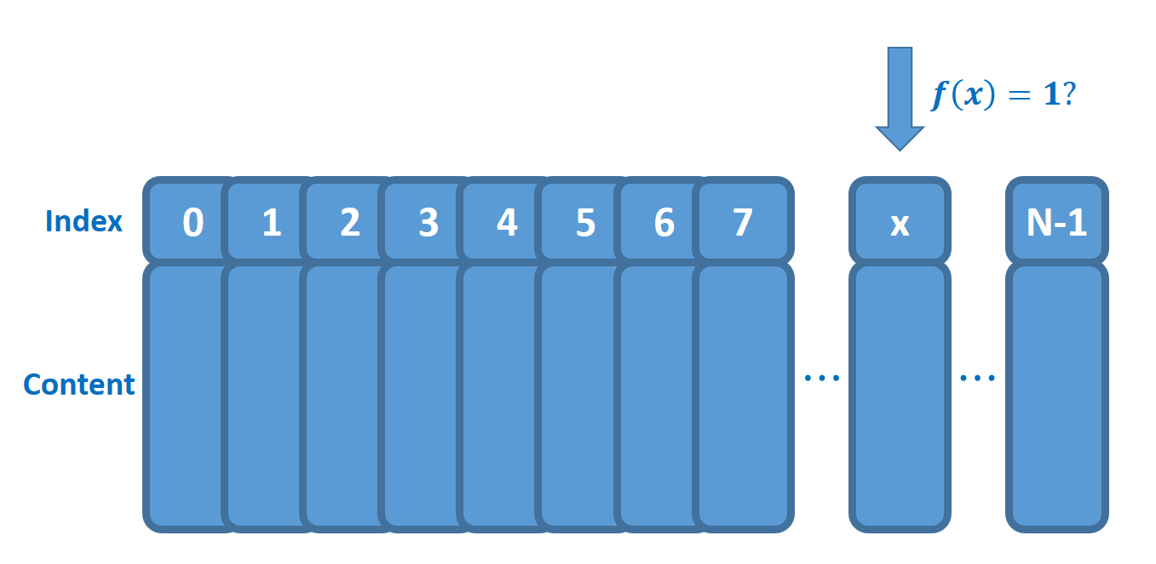

Grover’s Search Algorithm
N data in unstructured database
f(x==a) = 1 & f(x!=a) = 0
Average:
classical search
But: QC Grover’s algorithm

Slide 6
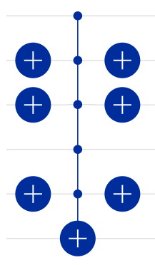

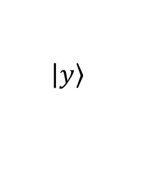
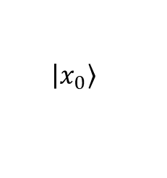
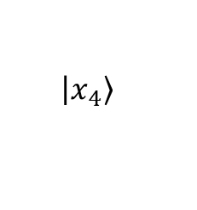
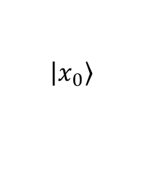
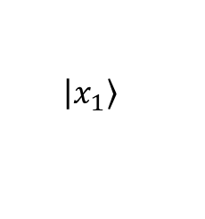
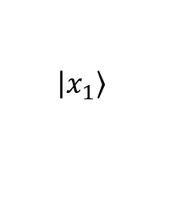
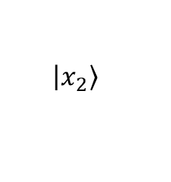
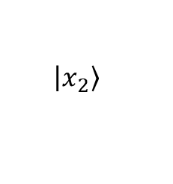
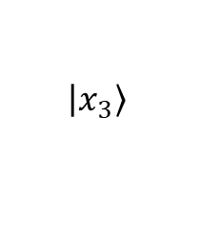
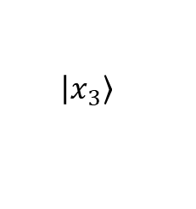
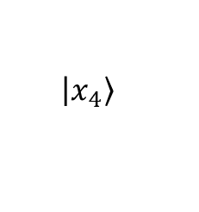
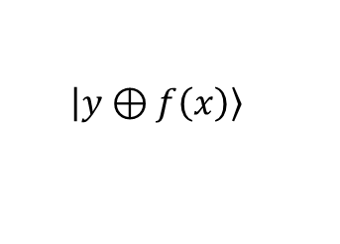
Example of an Oracle in Grover’s Algorithm
We encode x as the basis vector
Let a = 01001
$$\left|\left.x_{4}\right\rangle \right.$$
$$\left|\left.x_{4}\right\rangle \right.$$
$$\left|\left.x_{3}\right\rangle \right.$$
$$\left|\left.x_{3}\right\rangle \right.$$
An example(oracle)
$$\left|\left.x_{2}\right\rangle \right.$$
$$\left|\left.x_{2}\right\rangle \right.$$
$$\left|\left.x_{1}\right\rangle \right.$$
$$\left|\left.x_{1}\right\rangle \right.$$
$$\left|\left.x_{0}\right\rangle \right.$$
$$\left|\left.x_{0}\right\rangle \right.$$
$$\left|\left.y\right\rangle \right.$$
$$\left|\left.y⊕f\left(x\right)\right\rangle \right.$$

Slide 7
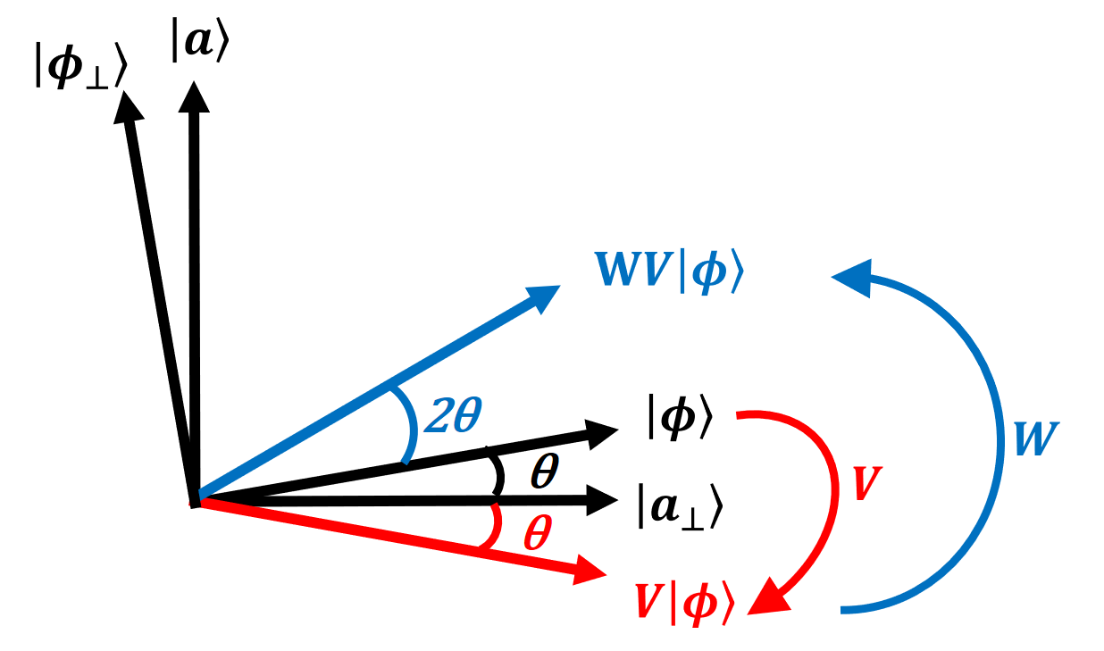
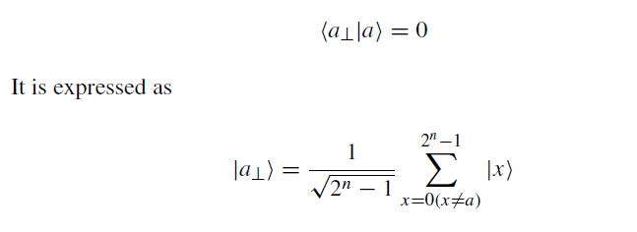
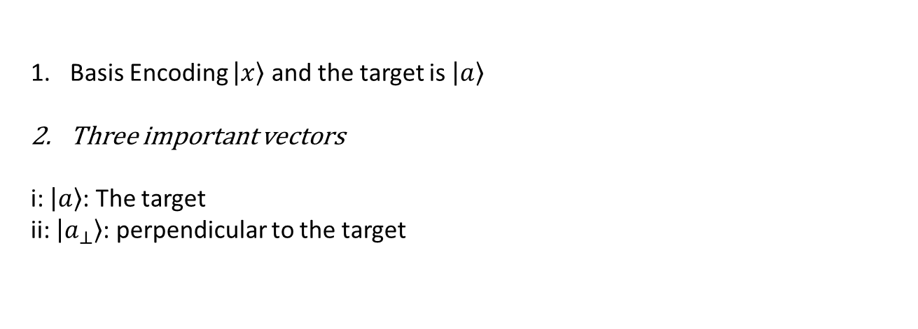
Overview of Grover’s Algorithm
Basis Encoding $\left|\left.x\right\rangle \right.$ and the target is $\left|\left.a\right\rangle \right.$
Three important vectors
i: $\left|\left.a\right\rangle \right.$: The target
ii: $\left|\left.a_{⊥}\right\rangle \right.$: perpendicular to the target

Slide 8

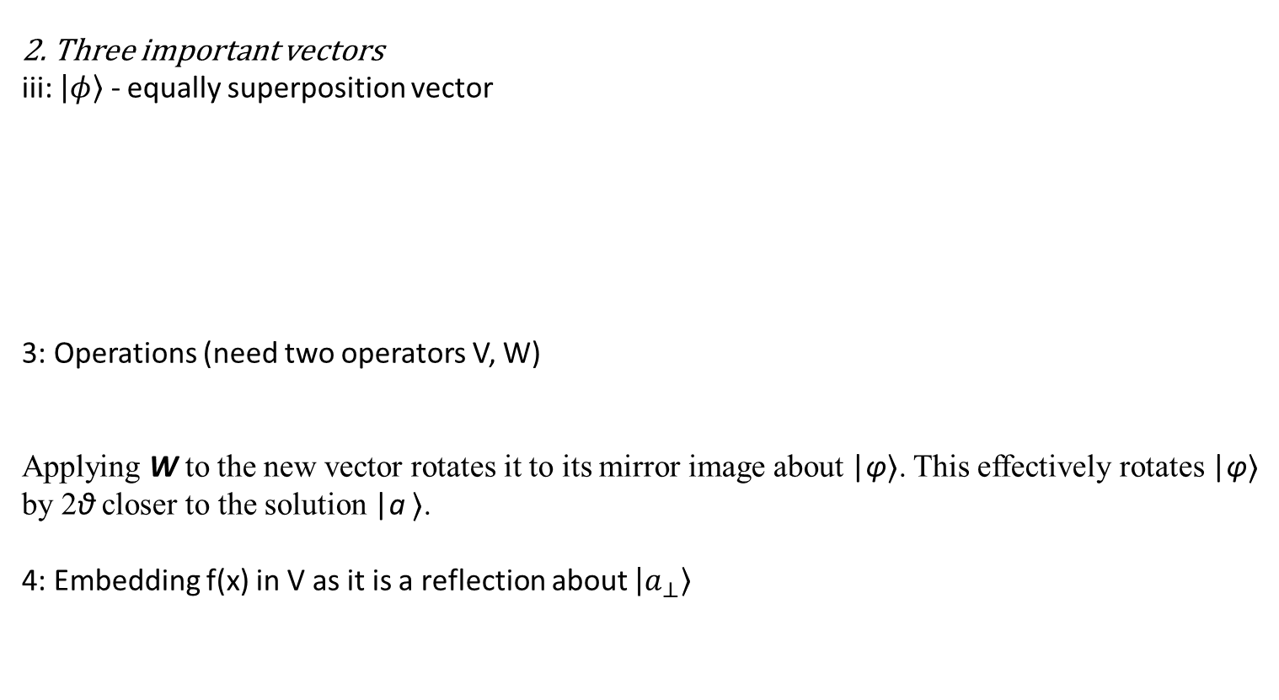
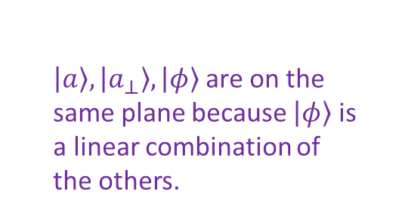
Overview of Grover’s Algorithm
2. Three important vectors
iii: $\left|\left.φ\right\rangle \right.$ - equally superposition vector
3: Operations (need two operators V, W)
Applying W to the new vector rotates it to its mirror image about |φ⟩. This effectively rotates |φ⟩ by 2θ closer to the solution |a ⟩.
4: Embedding f(x) in V as it is a reflection about $\left|\left.a_{⊥}\right\rangle \right.$
$\left|\left.a\right\rangle \right., \left|\left.a_{⊥}\right\rangle \right., \left|\left.φ\right\rangle \right.$are on the same plane because $\left|\left.φ\right\rangle \right.$ is a linear combination of the others.
Applying V to |φ rotates |φ⟩ to its mirror image about |a⊥⟩.

Slide 9
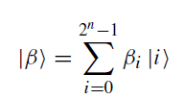

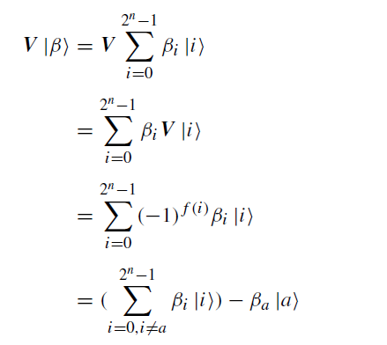
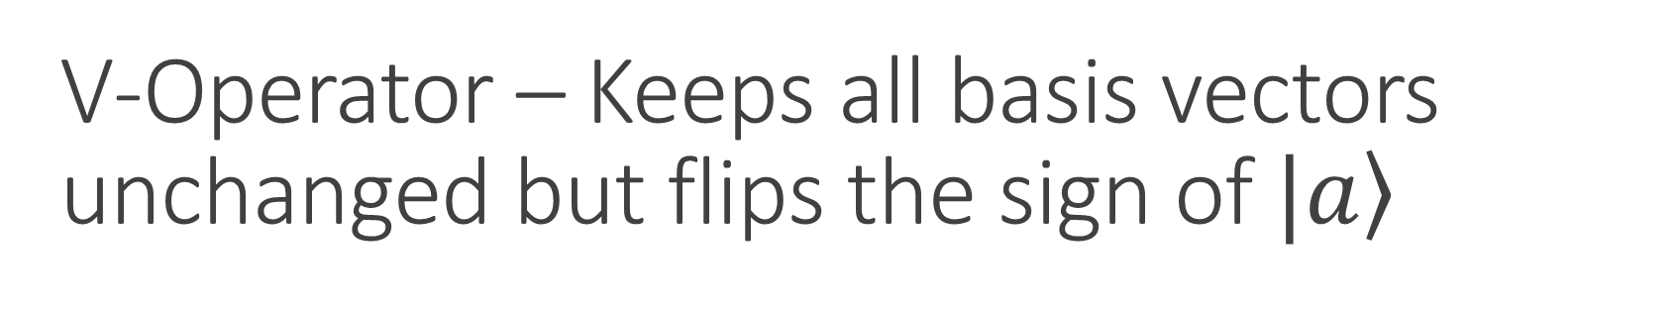
V-Operator – Keeps all basis vectors unchanged but flips the sign of $|\left.a\right\rangle$
Implementation of V

